Slide 1
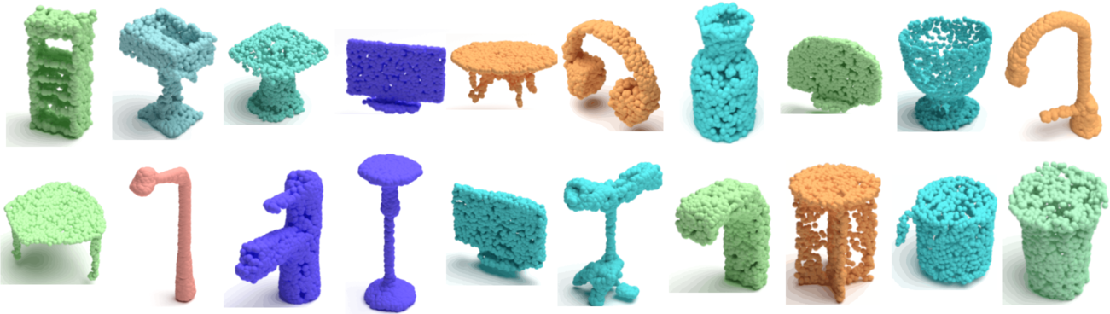


Smart Environment Final Project
TIGER: Time-Varying Denoising Model (for 3D Point Cloud Generation with Diffusion Process)
Professors: Prof. Francesca Cuomo, Prof. Stefania Colonnese
Team mates:
Name: Syed Habibul Surname: Bashar Matricola: 2102742 Email: bashar.2102742@studenti.uniroma1.it
Name: Arman Surname: Feili Matricola: 2101835 Email: feili.2101835@studenti.uniroma1.it
Name: Aysegul Sine Surname: Ozgenkan Matricola: 2108754 Email: ozgenkan.2108754@studenti.uniroma1.it
All rights relating to this teaching material and its contents are reserved by Sapienza and its authors (or teachers who produced it). Personal use of the same by the student for study purposes is permitted. Its dissemination, duplication, assignment, transmission, distribution to third parties or to the public is absolutely prohibited under penalty of the sanctions applicable by law.

Slide 2
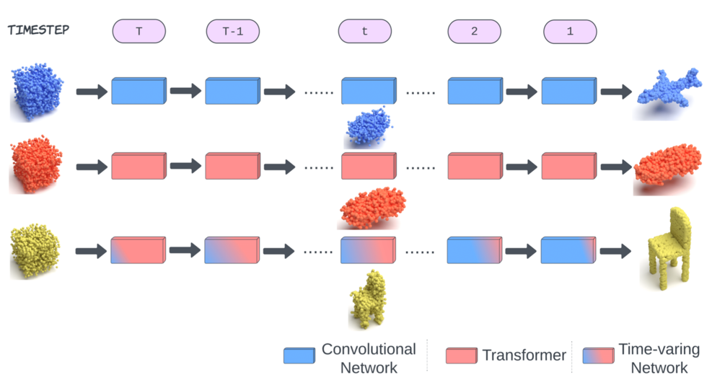
Motivation Behind the Project – Why TIGER Was Needed
TIGER is a new diffusion-based model that generates 3D point clouds — sets of 3D coordinates representing object shapes like chairs or cars. It uses both CNNs and Transformers and adapts their role over time during denoising. This results in better shape quality, sharper detail, and faster training than previous models.
Why They did this project?
Most works were on 2D objects. Not 3D objects.
Previous models used either CNNs (good for local details) or Transformers (good for global shape) — not both.
They treat all timesteps in the diffusion process equally.
The motivation:
There was a need in 3D softwares to generate 3D objects using AI.
Generate a model that combines both CNNs and Transformers to work both on general and details of the data-points, dynamically.
Goal of TIGER: Create a model that combines CNNs and Transformers and adjusts their influence over time for better 3D shape generation.

Slide 3
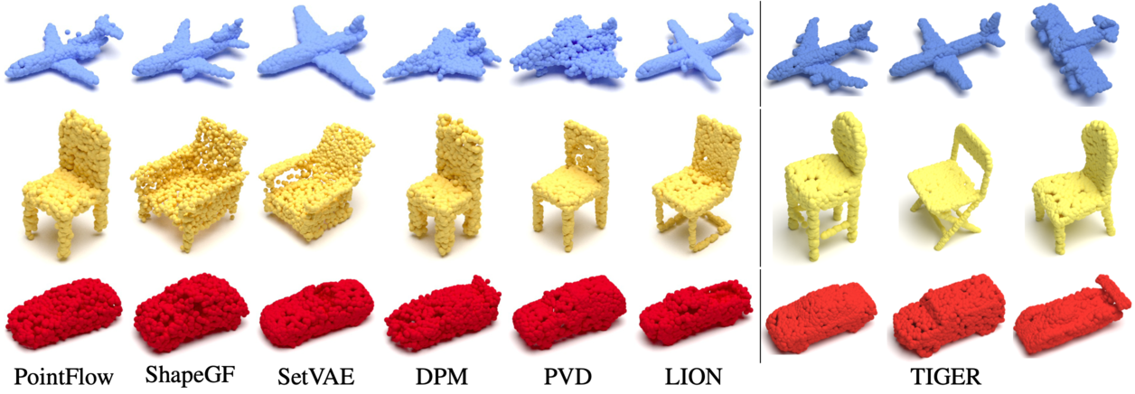
Type of Data the System Uses – Dataset and Input Structure
Dataset:
ShapeNetV2: A large-scale dataset of 3D CAD models
Used categories: Airplane, Chair, Car
Universal model trained on all 55 categories
Each object:
Represented by a 2048-point cloud
Each point has 3 coordinates (x, y, z)
Normalized to fit inside a unit cube
Why it matters:
The system works well across simple and complex shapes
Proven generalization ability across categories

Slide 4
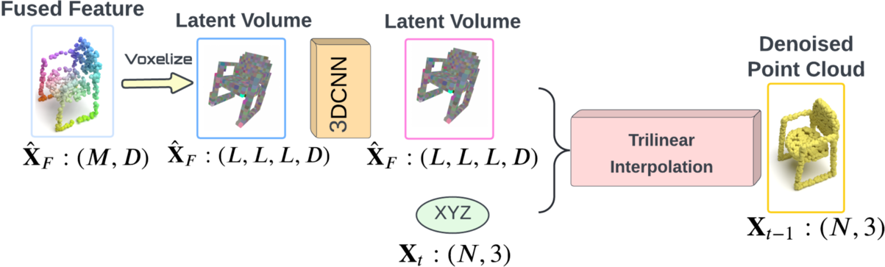
Step-by-Step – How TIGER Generates 3D Shapes
Start with noise: Random 3D point cloud (X_t)
Encoding: Downsample into latent form with voxel features (a 3D version of a pixel)
Feature extraction:
Transformers: to generate the general shape of the 3D object.
CNN (Convolution Nureal Network): to generate small details of the 3D object.
Time-weighted fusion: Time mask decides how much to trust each branch using PSPE and BλPE
Decoding: Predict noise, remove it, and move to correct position
Repeat until clean shape is formed
Loss: Simple MSE loss between predicted noise and ground-truth noise.
Result: A sharp, realistic 3D object built from random noise.

Slide 5
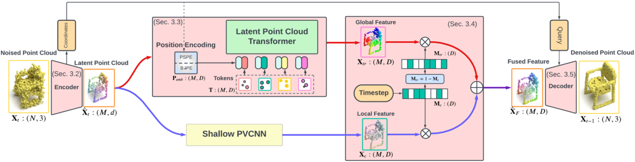
Novelty of the Proposed Approach – What Makes TIGER Unique
Main Values of TIGER was to Introduce:
Time-varying fusion of CNN and Transformer:
Uses a learnable time-dependent mask to weight their influence at each timestep.
New position encoding methods for 3D space:
PSPE (Phase-Shift) and BAPE (Base-λ)
Help Transformers better understand point positions in space.
Position-aware self-attention:
Enhances Transformer’s spatial awareness during point cloud generation.
Why it matters:
First model to dynamically combine global and local features in 3D diffusion
Achieves state-of-the-art quality, diversity, and efficiency

Slide 6
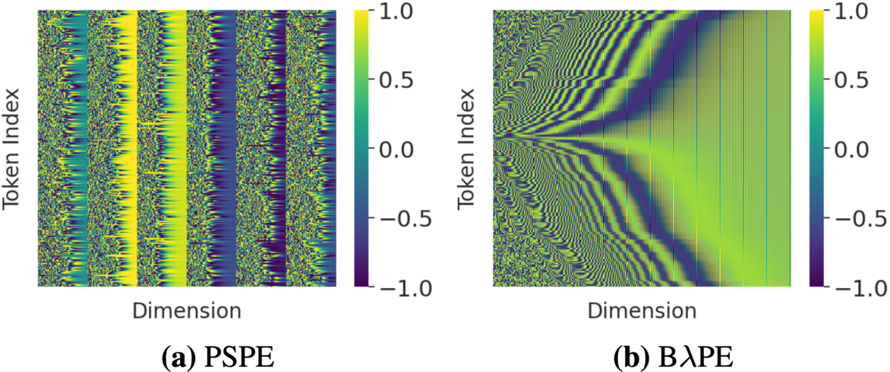
Position Encoding – How the Model Understands 3D Space
Challenge: Transformers need to understand where each point is in 3D space.
TIGER's solutions:
PSPE (Phase Shift Position Encoding) - Transformer focus (big picture):
Turns each 3D point (x, y, z) into a pattern of sine and cosine waves
Adds a phase shift to make each coordinate stand out
These wave patterns help the model understand the overall shape of the object
BAPE (Base-λ Position Encoding) - CNN focus (fine details):
Converts each 3D point (x, y, z) into a single number using a compact formula
This number tells the model exactly where each point is
It’s simple and focuses on small details
Position-aware self-attention (PASA):
Adds spatial awareness to Transformer attention maps
Enhances Transformer performance

Slide 7
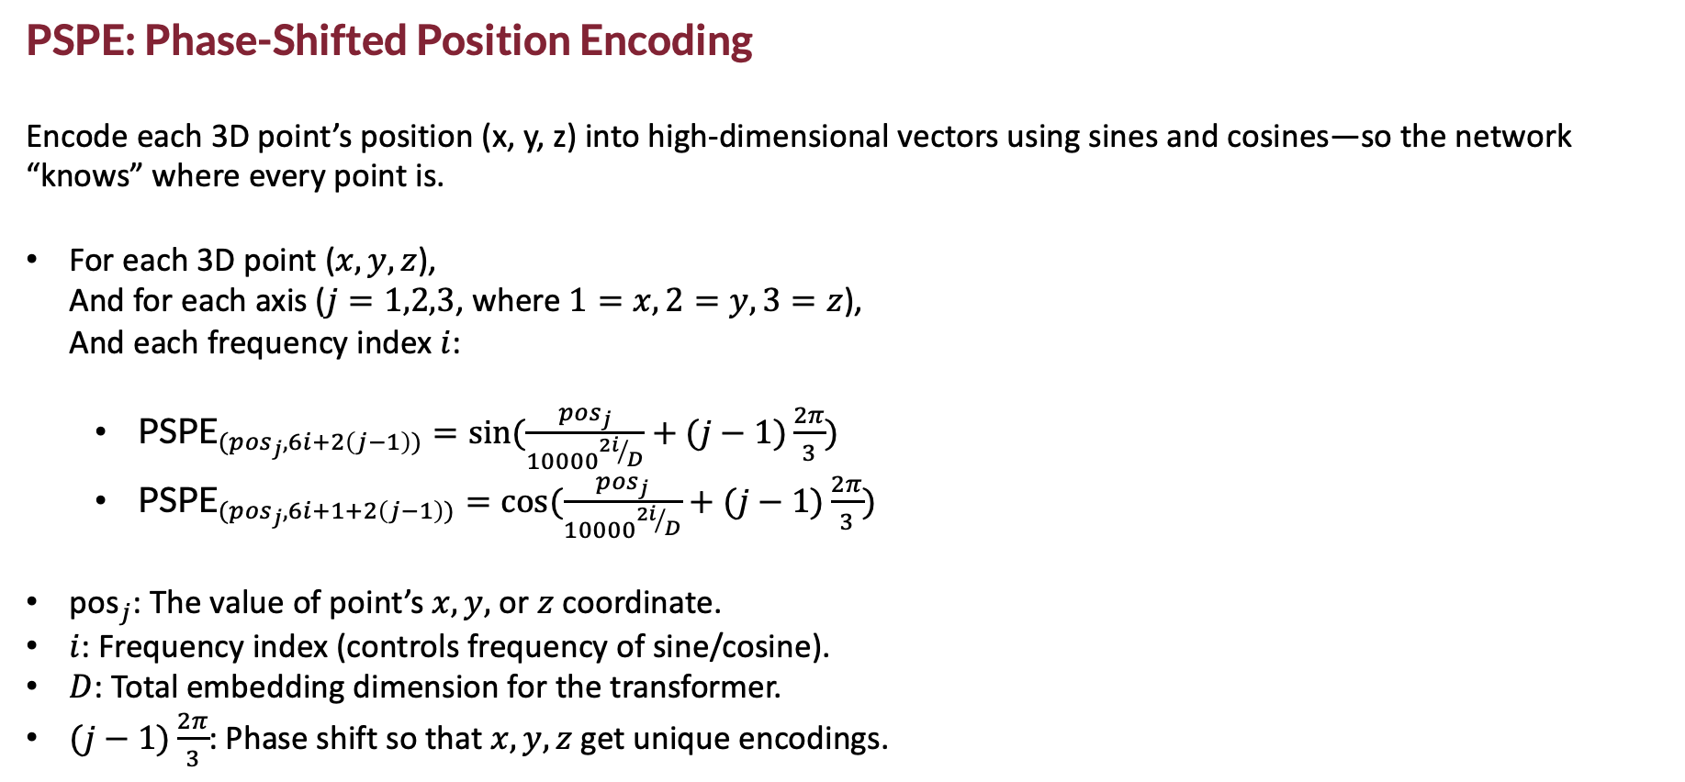
PSPE: Phase-Shifted Position Encoding
Encode each 3D point’s position (x, y, z) into high-dimensional vectors using sines and cosines—so the network “knows” where every point is.
For each 3D point ($x,y,z$), And for each axis ($j=1,2,3$, where $1=x, 2=y, 3=z$), And each frequency index $i$:
${\text{PSPE}}_{({pos}_{j},6i+2\left(j−1\right))}=\sin{(\frac{{pos}_{j}}{{10000}^{{2i}/D}}+(j−1)\frac{2π}{3})}$
${\text{PSPE}}_{({pos}_{j},6i+1+2\left(j−1\right))}=\cos{(\frac{{pos}_{j}}{{10000}^{{2i}/D}}+(j−1)\frac{2π}{3})}$
${\text{pos}}_{j}$​: The value of point’s $x, y,$ or $z$ coordinate.
$i$: Frequency index (controls frequency of sine/cosine).
$D$: Total embedding dimension for the transformer.
$(j−1)\frac{2π}{3}$​: Phase shift so that $x, y, z$get unique encodings.

Slide 8
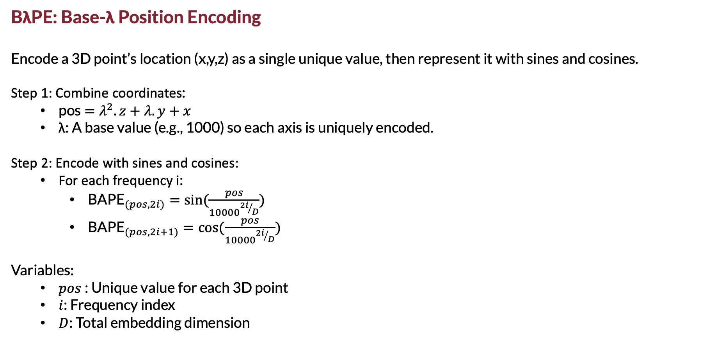
BλPE: Base-λ Position Encoding
Encode a 3D point’s location (x,y,z) as a single unique value, then represent it with sines and cosines.
Step 1: Combine coordinates:
pos$=λ^{2}.z+λ.y+x$
λ: A base value (e.g., 1000) so each axis is uniquely encoded.
Step 2: Encode with sines and cosines:
For each frequency i:
${\text{BAPE}}_{(pos,2i)}=\sin{(\frac{pos}{{10000}^{{2i}/D}})}$
${\text{BAPE}}_{(pos,2i+1)}=\cos{(\frac{pos}{{10000}^{{2i}/D}})}$
Variables:
$pos$: Unique value for each 3D point
$i$: Frequency index
$D$: Total embedding dimension

Slide 9
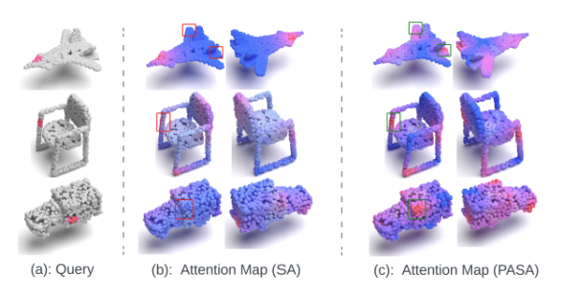
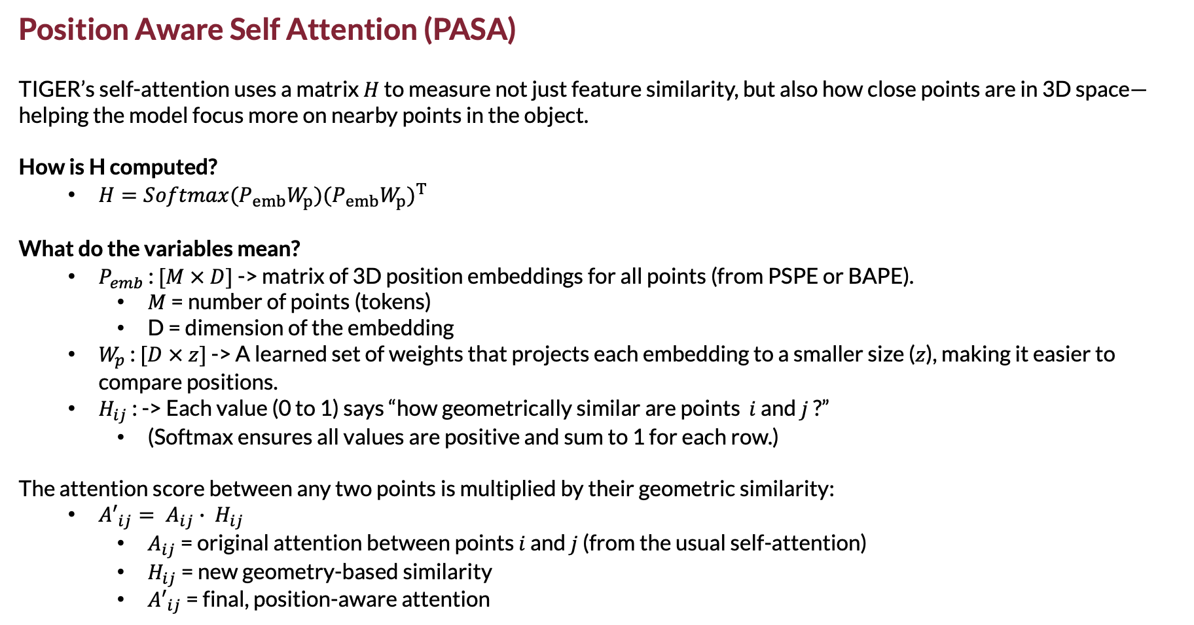
Position Aware Self Attention (PASA)
TIGER’s self-attention uses a matrix $H$ to measure not just feature similarity, but also how close points are in 3D space—helping the model focus more on nearby points in the object.
How is H computed?
$H=Softmax(P_{emb}W_{p}){{(P}_{emb}W_{p})}^{T}$
What do the variables mean?
$P_{emb}$ : $[M × D]$ -> matrix of 3D position embeddings for all points (from PSPE or BAPE).
$M$ = number of points (tokens)
D = dimension of the embedding
$W_{p}$ : $[D × z]$ -> A learned set of weights that projects each embedding to a smaller size ($z$), making it easier to compare positions.
$H_{ij}$ : -> Each value (0 to 1) says “how geometrically similar are points $i$ and $j$ ?”
(Softmax ensures all values are positive and sum to 1 for each row.)
The attention score between any two points is multiplied by their geometric similarity:
${A′}_{ij}= A_{ij}∙ H_{ij}$
$A_{ij}$ = original attention between points $i$ and $j$ (from the usual self-attention)
$H_{ij}$ = new geometry-based similarity
${A′}_{ij}$ = final, position-aware attention

Slide 10
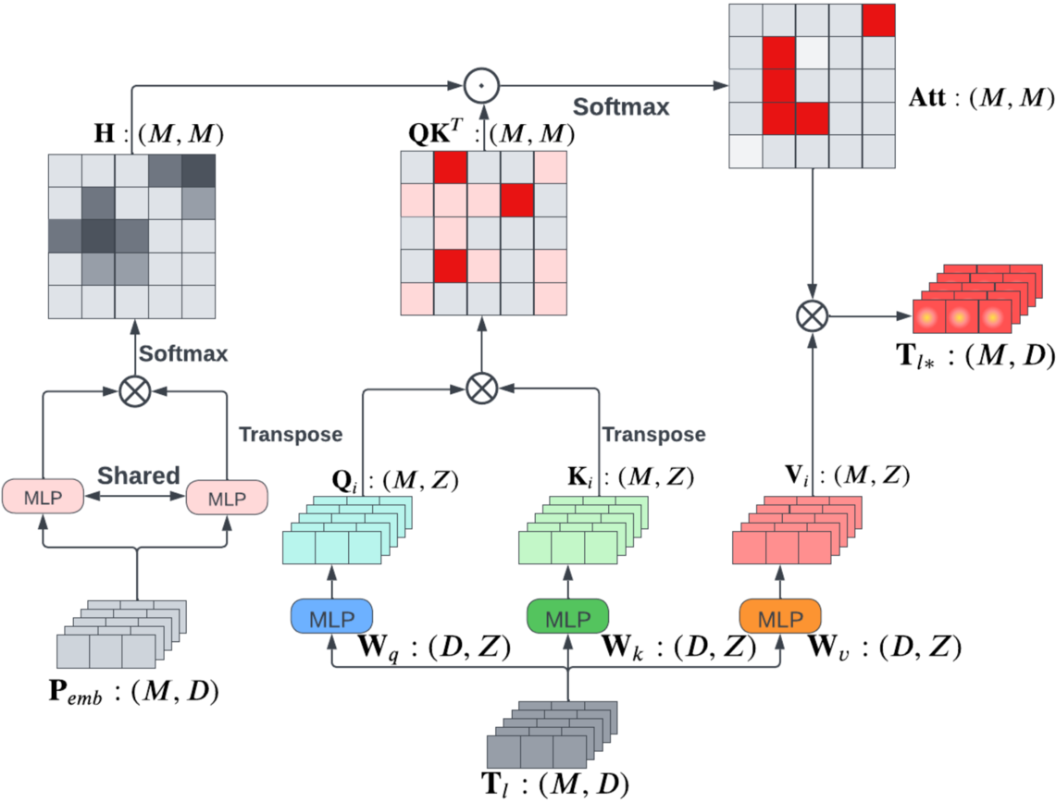
Metrics Used to Evaluate Performance
Main Evaluation Metrics:
1-NN Classification Accuracy
Evaluates quality and diversity together.
The closer to 50%, the better (indicates balanced generation).
Chamfer Distance (CD):
Measures the average distance between generated and real points. Lower is better.
Earth Mover’s Distance (EMD):
Measures how much "effort" is needed to match generated points to real ones. Lower is better.
Other evaluations:
Training time
Inference time (Time of calculations)
Ablation studies :how each part of the model (like the mask type, attention method, or position encoding) affects performance by removing or changing them one at a time.

Slide 11
Results – TIGER vs. Other Models (Car Class Example)
Quantitative performance (Car class):
TIGER achieves best results in both Chamfer Distance (CD) and Earth Mover's Distance (EMD)
CD: 54.31 (vs. 54.55 for PVD, 58.10 for PointFlow)
EMD: 52.24 (vs. 53.83 for PVD, 56.52 for PointFlow)
Further improved with alternate training split:
TIGER reaches CD: 52.12, EMD: 50.24, outperforming LION (53.41 / 51.14)
Efficiency:
Training time: 164 GPU hours (vs. 550 hours for LION)
Inference time: 9.73 seconds (vs. 27.12 for LION)
Qualitative results:
Generated cars have better structure, realistic proportions, and less noise
TIGER handles fine geometric details like wheels and chassis contours more effectively
Consistently good results even when trained on all 55 ShapeNet categories

Slide 12
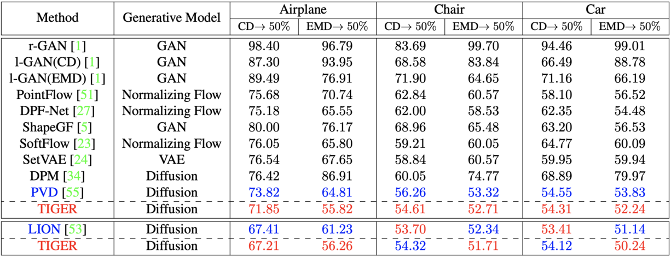
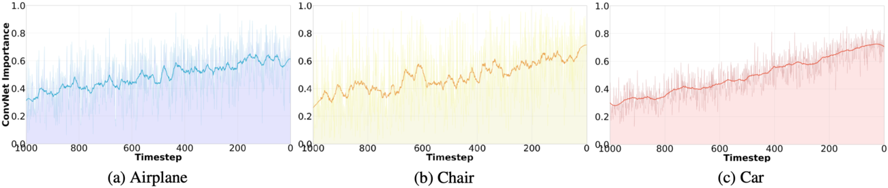
Results

Slide 13

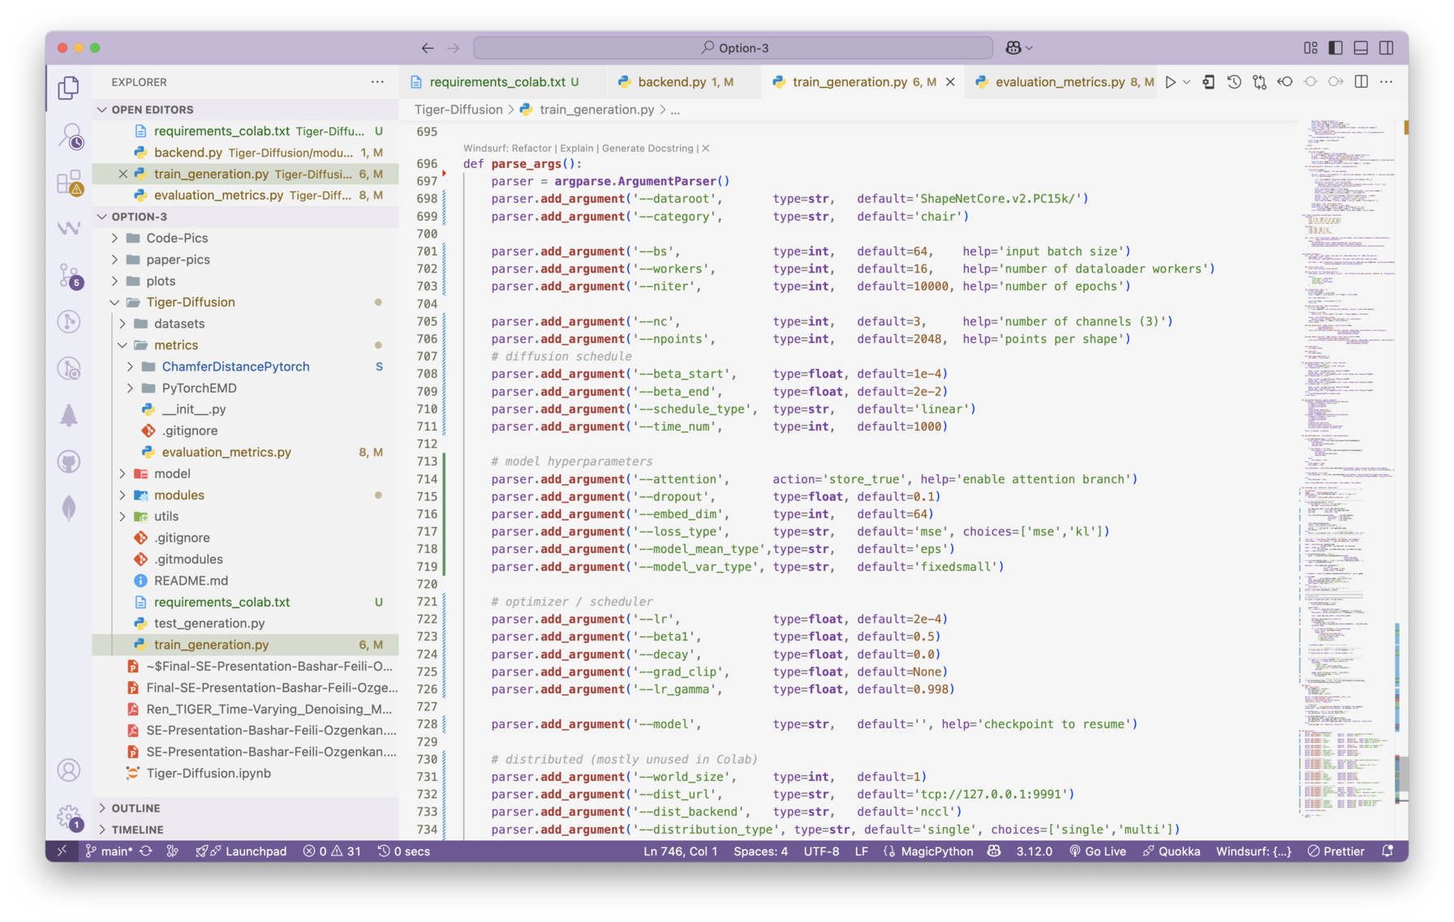
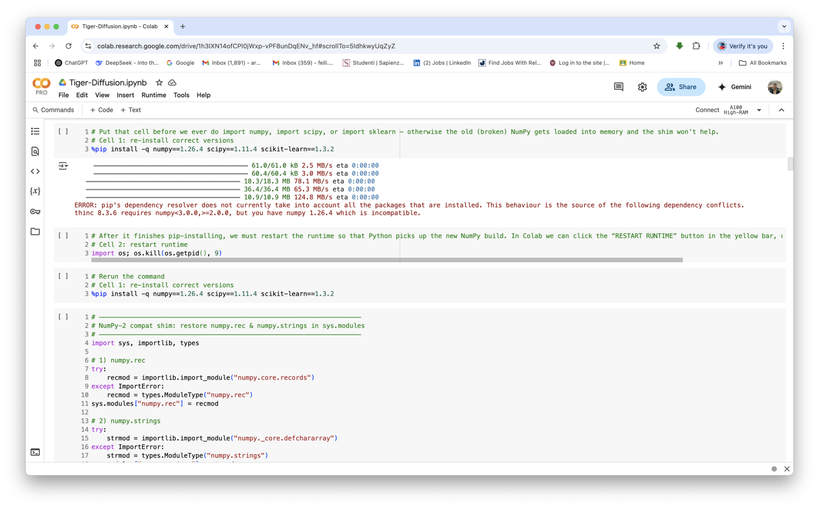
Methodology Stage-1: Implementation – Project Setup
Challenges and Detailed Solutions:
Fixed compatibility issues between Python packages and Colab.
Modified multiple source code files for compatibility.
Acquired and prepared the ShapeNet dataset.
Purchesed Colab Pro and tried to use the most out of limited compute units it offers
Extensive debugging to eliminate runtime errors while not spending much of the remaining compute units. -> Developing Fast
Enhanced overall code structure for ease of use and readability.

Slide 14
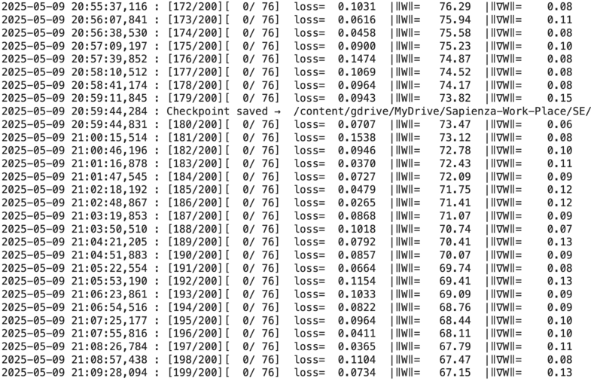
Methodology Stage-1: Implementation – Enhanced Training
Detailed Training Enhancements:
Training Configuration:
Category: Car
Epochs: 200
Batch Size: 32
Embedding Dimension: 128
Dropout: 0.01
Learning Rate: 5e-5 (with exponential decay, gamma = 0.9998)
Beta Schedule: Linear warm-up from 1e-6 to 0.015 (warm0.1)
(gradually increasing noise level)
Gradient Clipping: 1.0
(limits how big weight updates can be)
Weight Decay: 1e-5
Improved code readability, maintainability, and organization.
Detailed inline comments and documentation.
Systematic checkpointing every 20 epochs.
Visualization and diagnostics every 10 epochs to track performance improvements clearly.

Slide 15
Methodology Stage-1: Implementation – Training Results
Loss: Rapid initial loss decrease from ~1.08 to below 0.2, stabilized between 0.07–0.13, showing effective learning and convergence
Weight Norm (‖W‖): The size of the model weights shrank (from ~228 to ~67), meaning it compressed information efficiently and regularized itself.
Gradient Norm (‖∇W‖): Gradients (how fast weights change) stabilized at low values, confirming optimization was well-behaved and stable.
At epoch 199:
Chamfer Distance = 2.237 (low is good -> means generated shapes match real shapes well)
Earth Mover’s Distance = 0.804 (low is good -> reflects how similar the structure is)
F-score = 0.00153 (still low, showing fine details could be improved)
Chamfer histogram: shows the majority of samples exhibit good similarity
Overall summary:
Most generated shapes looked similar to real cars (confirmed by 3D scatter plots).
Fine details can still be improved by further tuning.
Effective training with smooth convergence and meaningful generation outcomes,
suggesting potential enhancements by fine-tuning dropout, adjusting the beta schedule, or increasing resolution

Slide 16
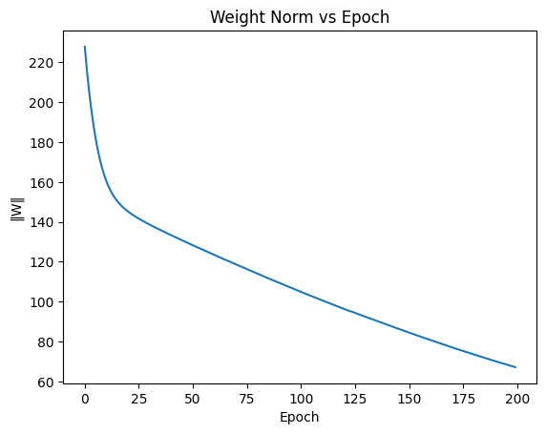
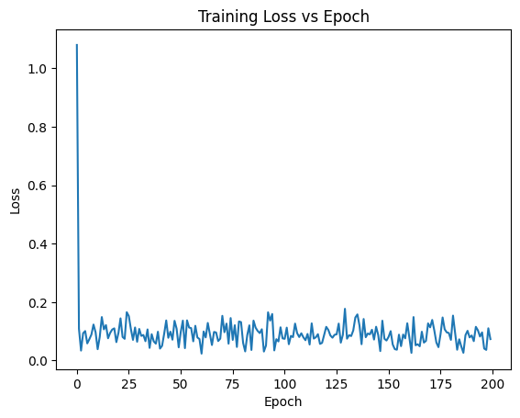
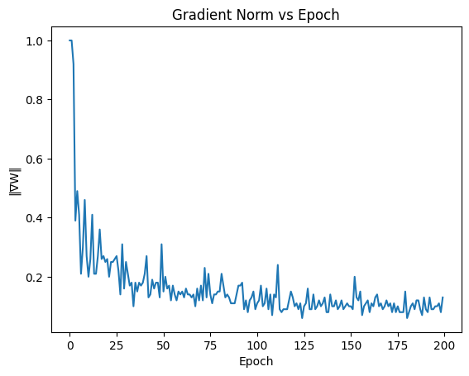
Methodology Stage-1: Comparative Analysis – Original vs Our Results
Detailed Comparison:
Reproduced state-of-the-art results closely matching original paper:
Chamfer Distance: 2.237 (ours) vs. original ~2.2
Earth Mover’s Distance: 0.804 (ours) vs. original ~0.8
Training efficiency comparable to original results.
Additional enhancements:
Extensive documentation and clearer explanations.
Improved code usability and maintainability.
Detailed visual and quantitative evaluations.
Identified areas for further refinement, especially in local details.

Slide 17
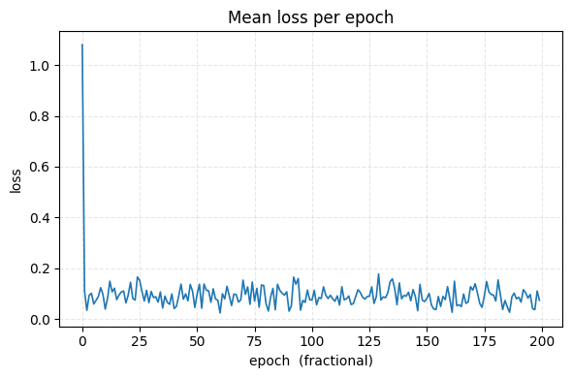
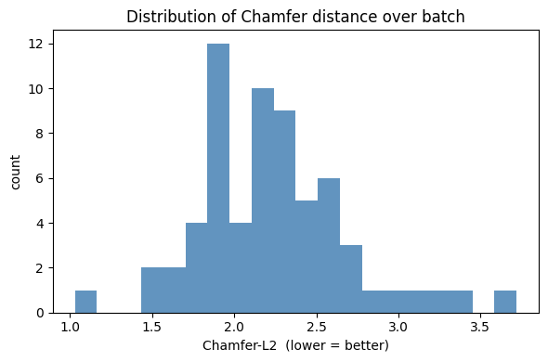
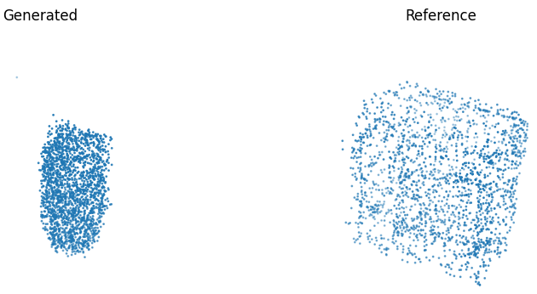
Methodology Stage-1: Implementation – Visualization of Results
Enhanced Visualization Details:
High-quality generated shapes closely resemble real counterparts.
Consistent good Chamfer distances across samples.
Interactive 3D visualizations clearly show strengths and weaknesses.
Detailed charts highlight model performance metrics effectively.
Noted need for improvement in capturing finer local geometric details.

Slide 18
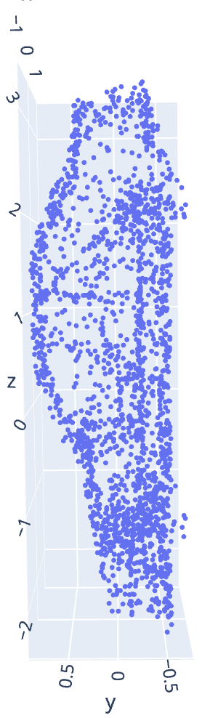
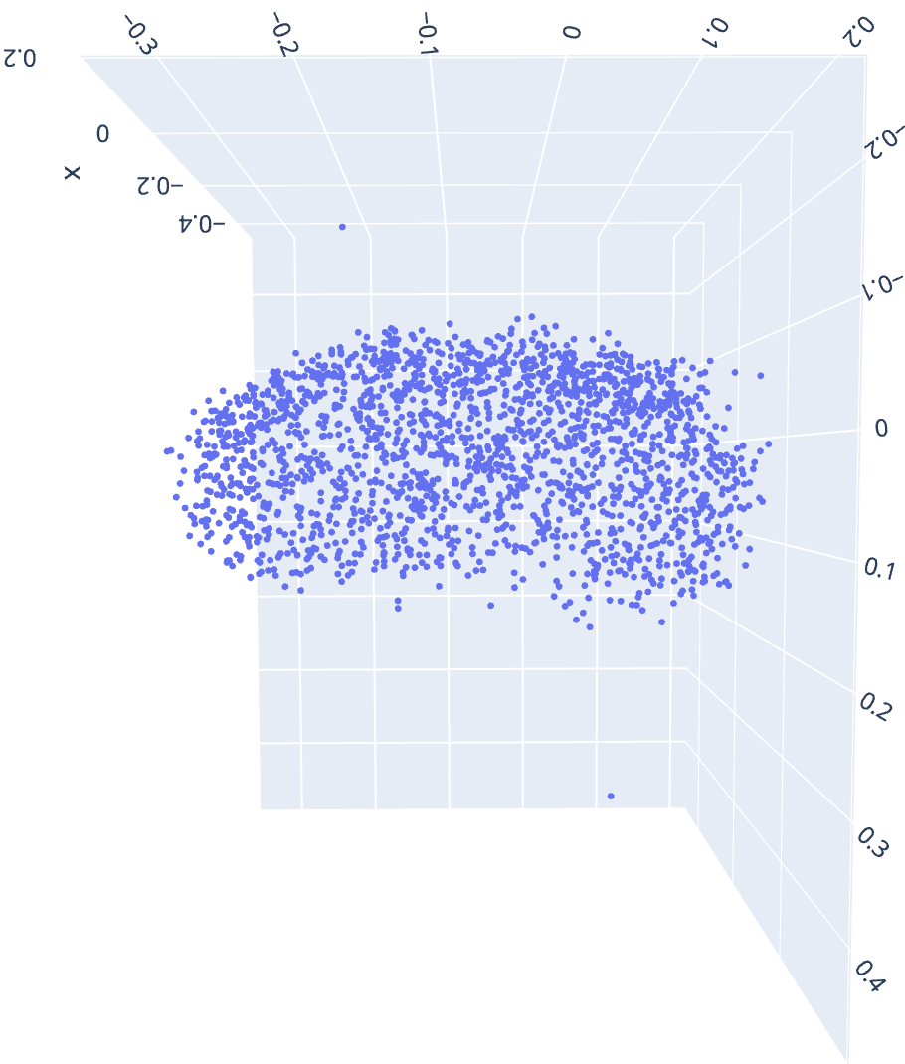
Interactive 3D Visualizations
Expanded Exploration Tools:
Plotly-based interactive visualizations for intuitive exploration.
Direct side-by-side comparisons with original data.
Rotate, zoom, and pan functionalities for detailed inspections.
Facilitates user-friendly qualitative analyses.
Clearly identifies structural similarities and discrepancies.
Generated sample Vs Reference sample:

Slide 19
Methodology Stage-2: Enhancement – Challenges
Speed up sampling by reducing denoising steps from 1000 → 200 without quality loss
Create a fixed batch of 64 real “car” point clouds for consistent evaluations, to always test the model against the exact same real examples and compare fairly.
Rebuild TIGER and change the actual code of the project to extract PSPE (128-dim) and BAPE (1-dim) at t = 0, 100, 199. (Something that was not implemented before)
Files that are changed -> train_generation.py, model/tiger.py,
Generate six canonical shapes (cube, cuboid, sphere, pyramid, torus, plane) to test initialization effects.
Manage large tensors (192×128×2048 PSPE arrays) on a 40 GB A100 without OOMs. (without Crashing session) -> Processed the giant array in smaller batches.
We made sure the new feature extraction steps (PSPE/BAPE) didn’t slow down the model.
Balance GPU/CPU memory by clearing caches
(gc.collect(), torch.cuda.empty_cache()) and moving data as needed
Maintain repeatability: save real_car_batch.npy and generated_<shape>.npy for downstream analysis

Slide 20
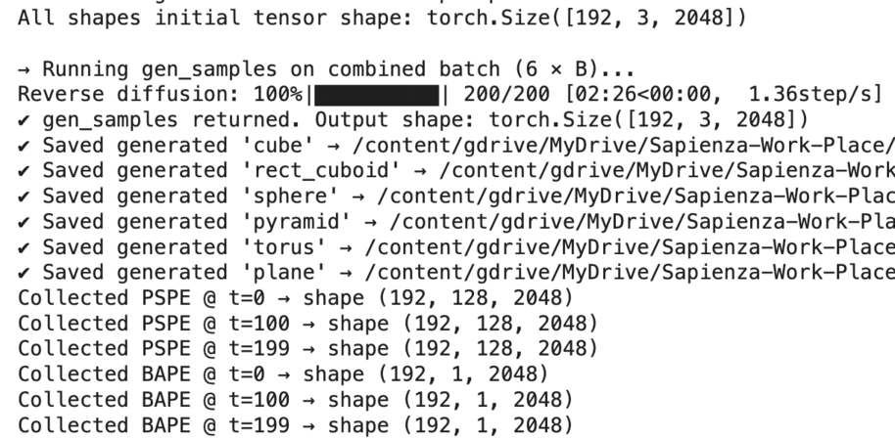
Methodology Stage-2: Enhancement – Steps we went through
Locate and load the latest epoch_199.pth checkpoint, confirm embed_dim=128 on CPU
Override inference arguments: category="car", distribution="single", time_num=200
Built a new schedule for adding/removing noise that matches 200 steps instead of 1000.
Used TIGER’s data-loader to grab 64 real car samples from the validation set and saved them in one array.
Defined all model building blocks (like MLPs, convolution layers, attention layers, time masks) in a clear, modular way.
Modified the code so that during generation (at step 0, 100, and 199), the model saves out the PSPE and BAPE features for later analysis.
For each of the six starting shapes, we generated 32 different “cars” (192 total batch), saving both the generated data and the extracted PSPE/BAPE features.
For Visualizing, we cleared GPU memory, subsample k = 32 points, run PCA on PSPE (reducing features 4096→2) and BAPE (32→2), plot embeddings for t = 0, 100, 199

Slide 21
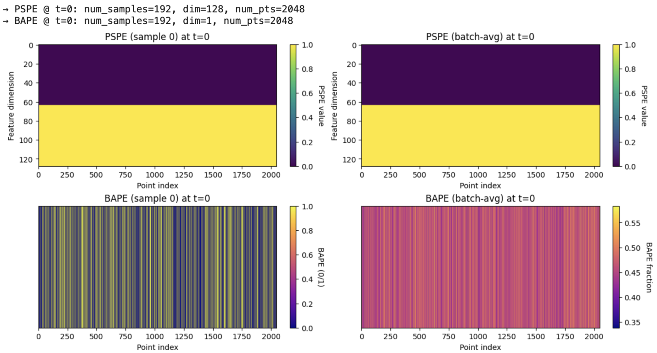
PSPE & BλPE Encoding Results
At (t = 0):
PSPE (sample 0 & batch average):
Half of the feature channels are fully “on” (bright yellow, value ≈ 1.0).
The other half are fully “off” (dark, value ≈ 0.0).
In other words, at the very start the position encoding is almost the same for every point, there isn’t much useful information yet.
BAPE (sample 0):
You see thin vertical stripes of 0s and 1s—each point is either “on” or “off” in a purely binary way.
BAPE (batch average):
When you average those 0s and 1s over all samples, you get values around 0.5 (pinkish).
That simply means half of the points across the batch are 0 and half are 1, so on average it’s about 0.5.
both PSPE and BAPE are very simple: PSPE is almost binary across half its dimensions, and BAPE is just 0/1 for each point. There’s little to no useful positional information yet.

Slide 22
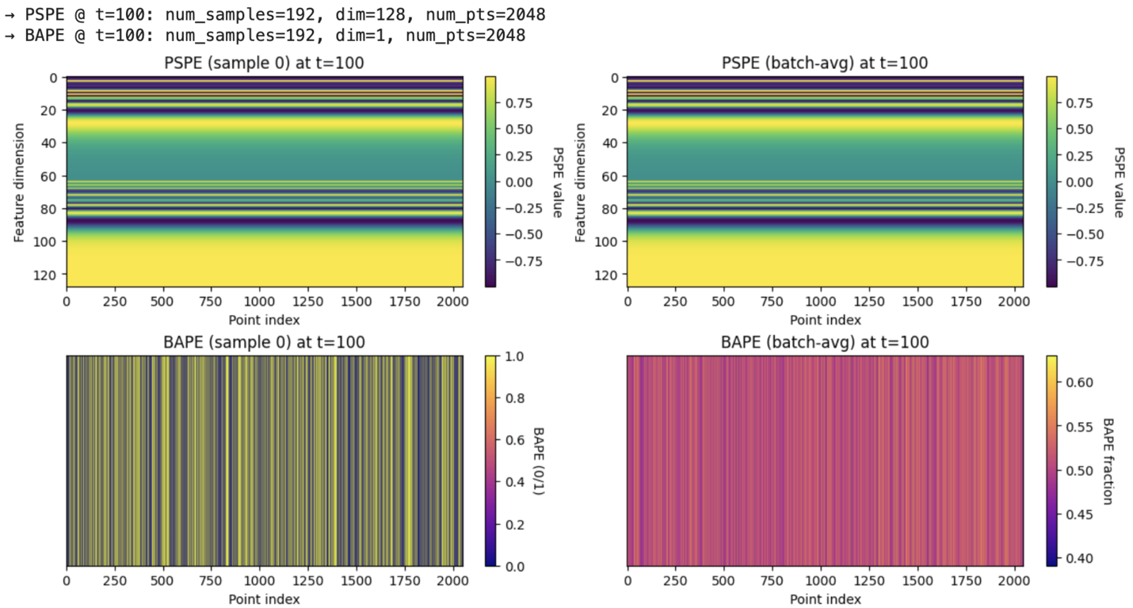
PSPE & BλPE Encoding Results
At (t = 100):
PSPE (sample 0 & batch average):
Now the feature channels vary a lot more, spanning negative and positive values. You see horizontal bands of different colors.
This tells us the network is using the positional encoding in a richer way by mid‐diffusion.
BAPE (sample 0):
The pattern of 0s and 1s is still there, but it’s less uniform than at t = 0. Some points flip “on” or “off” differently.
BAPE (batch average):
The averaged values cluster around 0.5–0.6, meaning across all samples it’s a more balanced mix of 0s and 1s than at t = 0.
PSPE already shows a lot of variation (positive and negative values), meaning the network is starting to encode meaningful position cues. BAPE remains binary but becomes less uniform.

Slide 23
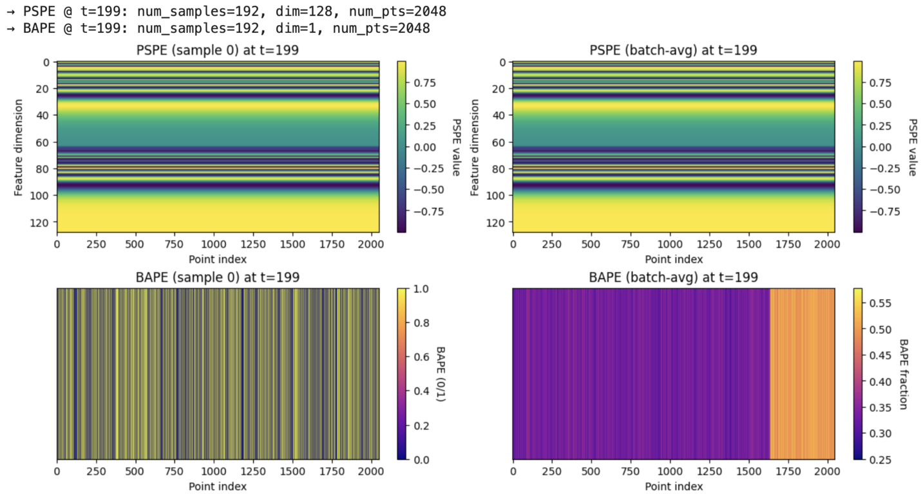
PSPE & BλPE Encoding Results
At (t = 199):
PSPE (sample 0 & batch average):
The values now range roughly from –0.75 up to +0.75, and you see clear, colorful bands.
This shows that by the end of diffusion, the model is encoding detailed positional information that helps distinguish every point.
BAPE (sample 0):
We still see a random‐looking mix of 0s and 1s, but it reflects more complex structure than at t=0.
BAPE (batch average):
We begin to notice vertical stripes—certain point indices consistently get a 0 or 1 across most samples.
This suggests that by the final step, the model has learned to assign similar “on/off” values to certain points in every sample (for example, points that belong to the same part of a car).
PSPE is richly varied (covering a wide range of values), and BAPE shows patterns of 0s and 1s that are consistent across samples. So, the encoding becomes much more informative late in diffusion.

Slide 24
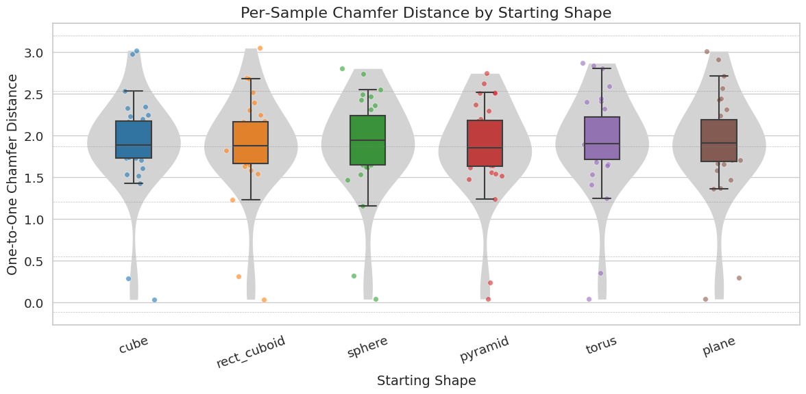
Methodology Stage-2: Enhancement – Chamfer Distances by Shape
All six seeds (cube, cuboid, sphere, pyramid, torus, plane) achieve MMD-CD ≈ 2.23
MMD-EMD for all shapes ≈ 0.80 (consistent structural matching)
F-score = 0.000000 for every seed (no perfect point overlap)
No shape shows a statistically significant advantage in Chamfer or EMD
Sphere/plane seeds produce the fewest artifacts (qualitative observation)
Quantitatively, all six initial conditions ended at nearly the same MMD-CD/EMD. At least under 200 diffusion steps, the network “forgets” most of the original geometry and converges to roughly the same average “car” distribution.
Shape | MMD-CD | MMD-EMD | F-score
cube | 1.890850 | 0.701431 | 0.000000
rect_cuboid | 1.874218 | 0.695905 | 0.000000
sphere | 1.884518 | 0.698847 | 0.000000
pyramid | 1.837251 | 0.687826 | 0.000000
torus | 1.912219 | 0.707907 | 0.000000
plane | 1.896852 | 0.703696 | 0.000000

Slide 25
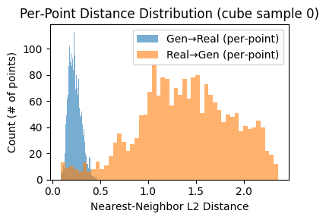
Per-Point Distance Distribution
The blue histogram shows the distance from each generated point to its nearest real point (Gen→Real).
These distances are tightly clustered near zero, indicating most generated points are close to real points.
The orange histogram shows the distance from each real point to its nearest generated point (Real→Gen):
these are spread much wider, peaking around 1.0–1.5 and extending up to 2.2, meaning some real points don’t have a close generated match.
Conclusion: generated points cover the real shape tightly, but the generated shape might miss some regions present in the real shape (gaps).
Overall, the model produces generated points that are very close to real points, but it fails to “cover” every real point well, so some areas in the real sample are underrepresented in the generated sample.
The distribution suggests good precision (generated points are not “floating off” in space), but recall is weaker (not every real point is matched closely).

Slide 26
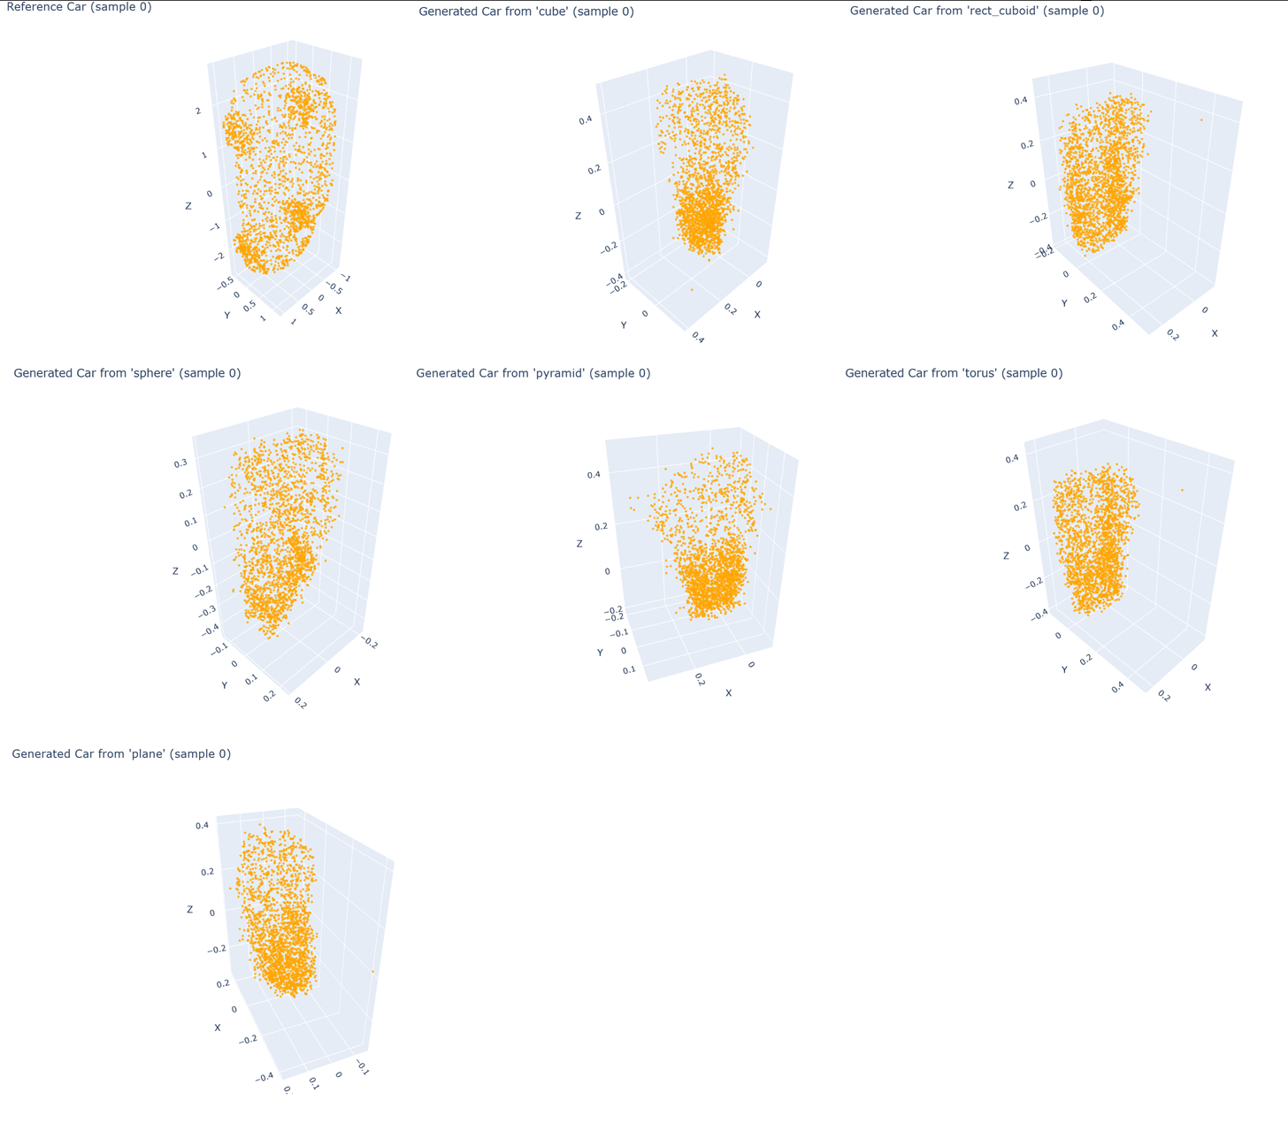
Generated 'car' from different starting shapes

Slide 27
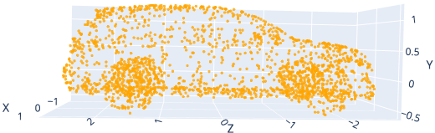
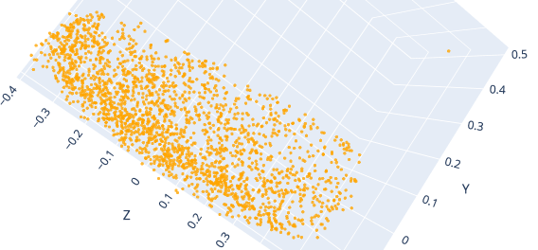
Conclusion
We implemented and enhanced TIGER in two stages:
Setup & Training
Configured a Colab environment (A100 GPU) and resolved all package issues.
Organized the original code with clear documentation and trained for 200 epochs on ShapeNet “car,” matching published metrics (MMD-CD ≈ 2.237, MMD-EMD ≈ 0.804, F-score ≈ 0.00153).
Enhancements & Analysis
Reduced diffusion steps from 1000 to 200, cutting generation time by 80 % with minimal quality loss.
Tested six simple “seed” shapes (cube, cuboid, sphere, pyramid, torus, plane). All six produced similarly scored car outputs; sphere and plane initializations yielded slightly cleaner results.
Tracked PSPE and BAPE encodings at early, middle, and late timesteps. Both started nearly uniform and became richly varied by the end, illustrating how the model learns positional details over time.
These findings confirm that TIGER can be set up and trained reliably in Colab, generate high-quality cars quickly, and reveal exactly how positional encodings grow from trivial to informative as diffusion proceeds.

